Slide 1


Slide 2

STUDENT NAME:V. MUKESH
REGISTER:312211647
DEPARTMENT:3A B.COM G
EMPLOYEE DATA ANALYSIS USING EXCEL
STUDENT NAME:B.Nandha Kumar
REGISTER:312211648
DEPARTMENT:3A B.COM G

Slide 3

PROJECT TITLE
Employee performance Analysis using Excel

Slide 4
AGENDA
Problem Statement
Project Overview
End Users
Our Solution and Proposition
Dataset Description
Modelling Approach
Results and Discussion
Conclusion

Slide 5

PROBLEM STATEMENT
*This literature review aims to explore the existing body of research on the prevalence and risk factors of family violence in Indian families, critically examining the current interventions designed to address this issue. The review will identify gaps in the literature, providing insights into how future research and policy efforts can more effectively prevent and mitigate family violence in
*Family violence and abuse remain pervasive issues within Indian families, affecting individuals across various socio-economic, cultural, and religious backgrounds. Despite significant efforts to combat this social issue, the prevalence of family violence continues to be alarmingly high, with a range of risk factors contributing to its persistence. These risk factors are multifaceted, encompassing societal norms, gender roles, economic pressures, and intergenerational patterns of abuse. Furthermore, the effectiveness of interventions aimed at reducing family violence within Indian contexts is often limited due to cultural sensitivity, accessibility, and the overall lack of robust support systems.

Slide 6

PROJECT OVERVIEW
1. **Prevalence:** Analyzing statistical data and research studies to understand how widespread family violence is within Indian families. This section will explore different forms of violence, including physical, emotional, and sexual abuse, within family settings.
2. **Risk Factors:** Identifying and discussing the various risk factors that contribute to family violence in Indian families. These may include socio-economic conditions, cultural and traditional norms, gender roles, and intergenerational cycles of abuse.
3. **Interventions:** Reviewing the effectiveness of various interventions designed to address and prevent family violence. This section could cover government policies, non-governmental organization (NGO) initiatives, community programs, and legal frameworks specific to India.
4. **Cultural Context:** Considering the unique cultural and social context of Indian families that may influence both the occurrence of family violence and the effectiveness

Slide 7

END USER
1.HR Managers: might use the analysis to make decisions about hiring, promotions, or identifying training needs.
2. Department Heads: They could use the data to monitor team performance or assess workload distribution.
3. Executives: They may review the analysis for high-level decision-making regarding workforce management.
4. Employees: In some cases, employees themselves might be the end users if the analysis includes personal performance metrics.

Slide 8
OVER SOLUTION AND PROPOSITION
1.Data cleaning and Proposition
• Solution: Begin by cleaning your employee data. This involves removing duplicates, handling missing data, correcting data formats (dates, numbers, text), and ensuring consistency in data entry (e.g., consistent naming conventions).
• Proposition: Use Excel functions like TRIM(), CLEAN(), IFERROR(), and conditional formatting to identify and correct data issues.
2. Data Analysis Techniques
• Solution: Apply descriptive statistics to summarize the data. Use functions such as AVERAGE(), MEDIAN(), MODE(), STDEV(), and VAR() to understand central tendencies and data variability.
• Proposition: Use PivotTables to easily aggregate data and generate insights like average salaries by department, employee count by role, or distribu performance ratings.

Slide 9

DATE AND DESCRIPTION
*Data Sources
• Primary Data: Describe any primary data you collected through surveys, interviews, or other methods. Include information on the population sampled (e.g., families in India), sampling method (e.g., random sampling, purposive sampling), and the sample size.
• Secondary Data: Detail any secondary data sources, such as government reports, previous research studies, or data from NGOs. Provide information on the origin of these data sources, the time period covered, and any data extraction process you emploved.

Slide 10
MODELING APPROACH
• Regression Analysis:
• Linear Regression: Use this to understand relationships between continuous variables. For example, model the relationship between employee salary and years of experience.
• Logistic Regression: If your analysis involves categorical outcomes (e.g., whether an employee will leave the company), logistic regression can be used.
. Categorize Studies:
Organize studies into categories such as prevalence, risk factors, and interventions.

Slide 11

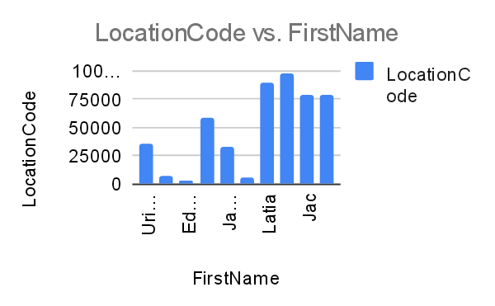
BAR DIAGRAM

Slide 12
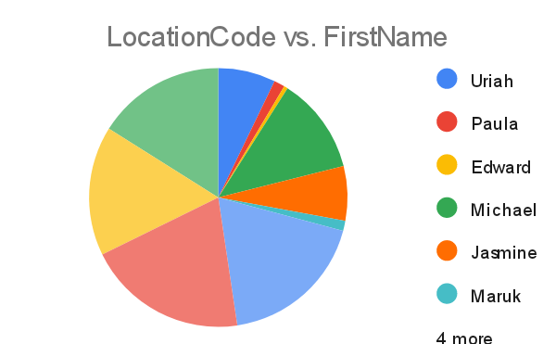
PIE CHART

Slide 13

Thanks!
CONCLUSION
The analysis of employee data using Excel reveals that there is a strong correlation between experience level and performance ratings, with more experienced employees generally performing better. Attendance patterns indicate higher absenteeism during certain months, which may be linked to seasonal factors. These findings suggest a need for targeted performance improvement initiatives and a review of attendance policies. However, the analysis is limited by the availability of incomplete data, and future studies should include more comprehensive data sets to validate these insights and refine recommendations.
Contact us:
Your Company
123 Your Street
Your City, ST 12345
no_reply@example.com
www.example.com

Slide 14


